Slide 1
Installation Guide
(Eclipse Plug-in – Anyframe Tools)
2008. 12. 12
CODELABOR
Shin Sang Jae (codelabor@gmail.com)

Slide 2
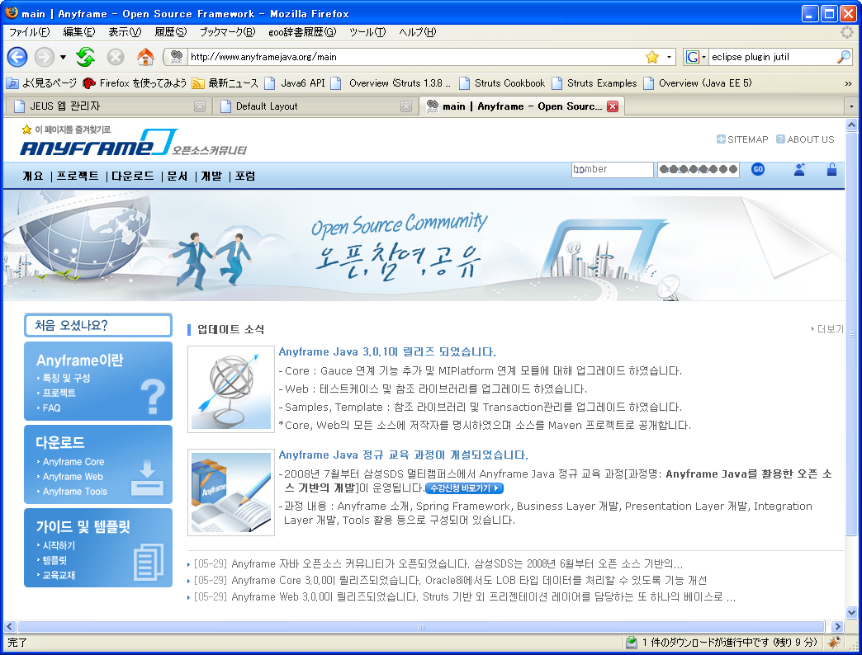
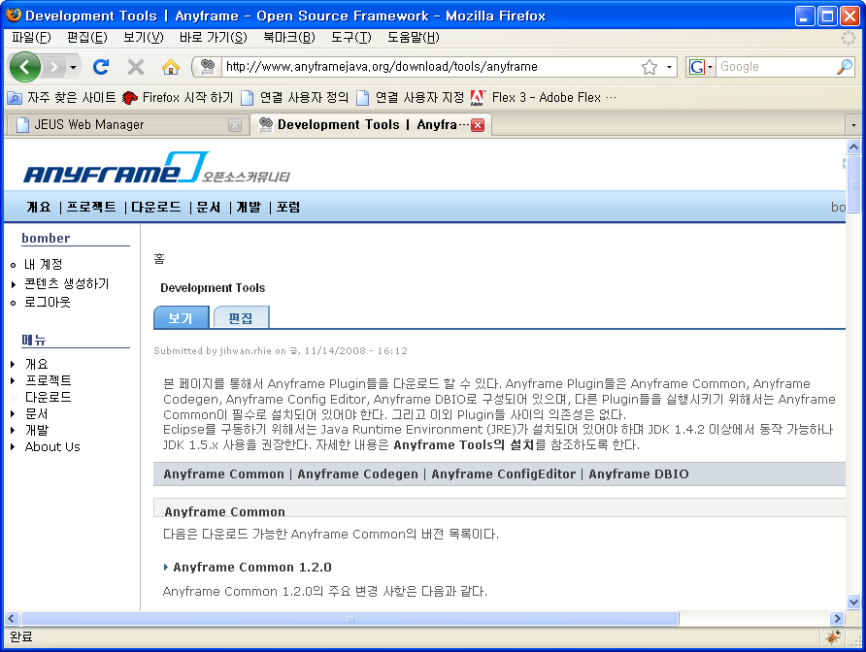
Eclipse Plug-in
Install
Eclipse Anyframe plug-in
Officical Site URL: http://www.anyframejava.org/main
Download Site URL: http://www.anyframejava.org/download/tools/anyframe
Download Files:
  anyframe.plugins.common-1.2.0-bin.zip
  anyframe.plugins.configeditor-2.1.0-bin.zip
  anyframe.plugins.codegen-1.3.0.M2-bin.zip
  anyframe.plugins.dbio-1.2.1-bin.zip

Slide 3
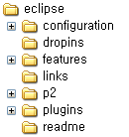
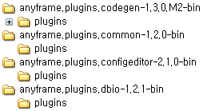

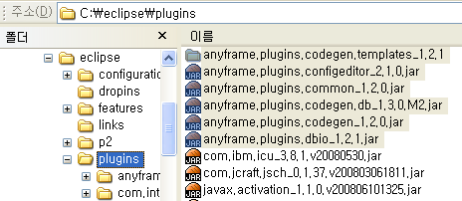
Eclipse Plug-in
Install
Unzip
Overwrite plugins directory

